Slide 1
Chapter 3 - captured

Slide 2
Chapter 3 - Captured

Slide 3
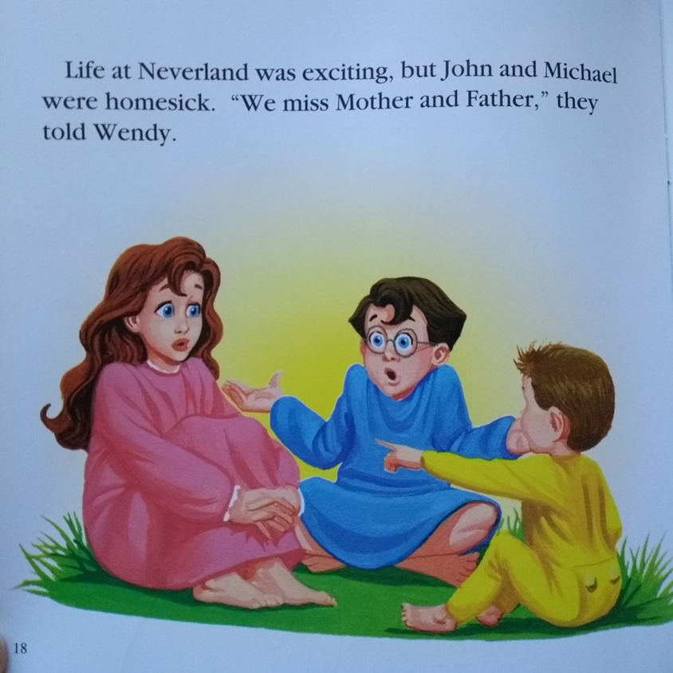

Slide 5
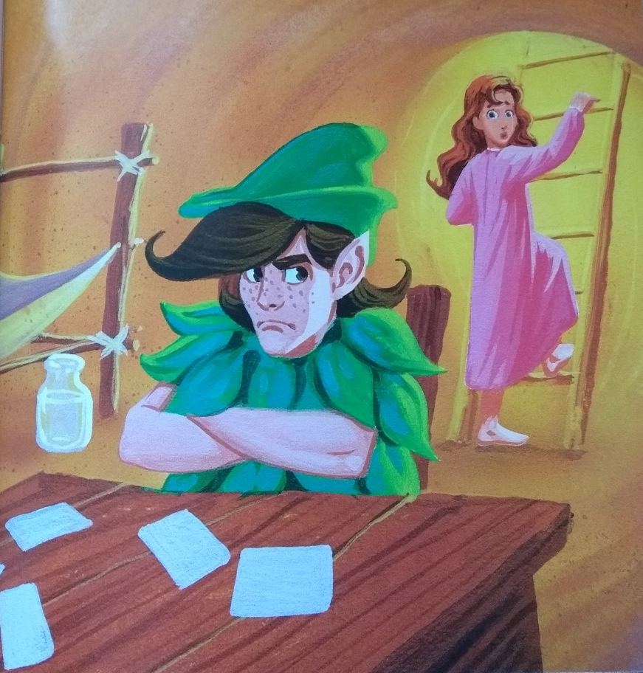

Slide 6
